Slide 1

1st VALSE Workshop on Pixel level image understanding
http://mmcheng.net/pixelund/
VALSE 2018 · 大连
20th April
Ming-Ming Cheng
Notes:
建议报告和提问总时长：45分钟。

Slide 2

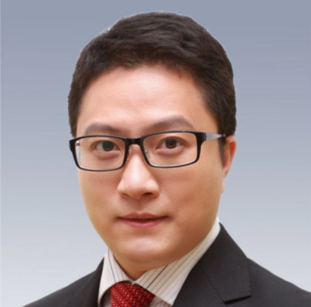
Workshop Organizers
程明明 (南开大学)
林倞(中山大学)

Slide 3

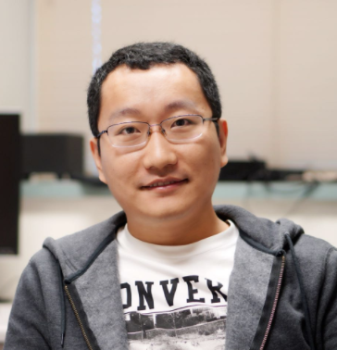

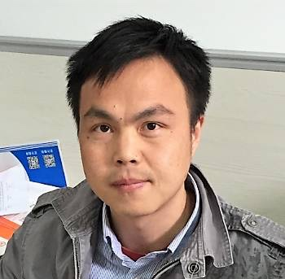

Invited Speakers
刘偲 (信工所)
魏云超 (UIUC)
董超 (商汤)
王兴刚 (华科)
程明明 (南开)

Slide 4

Learning Pixel Accurate Image Semantics from Web
Speaker: Ming-Ming Cheng
Nankai University
http://mmcheng.net/
Ming-Ming Cheng
Notes:
建议报告和提问总时长：45分钟。

Slide 5
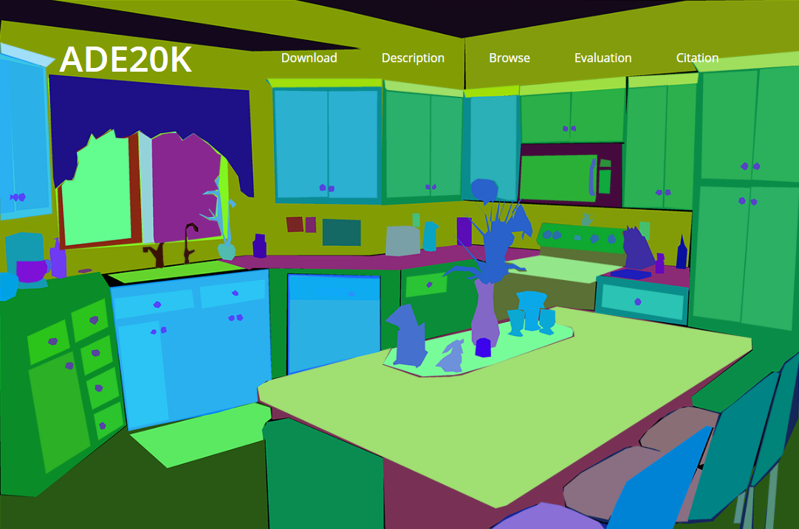
Dataset Annotation

Slide 6
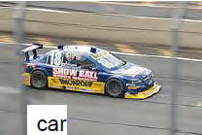


Dataset Annotation
PASCAL 11:
10? workers
27.374 bounding boxes
ImageNet:
25.000 workers
11.231.732 images labeled with one word
ADE20K:
Prof. Torralba’s mother labeled 213.841 segmented objects
Job offer: I am looking for more parents
CVML 2012, Antonio Torralba

Slide 7

How do we learn ourselves?

Slide 8
Question
Could we get ride of user annotation process?
Even keywords level supervision would needs significant efforts to learn new categories.
Could a machine vision system learn from web?
Autonomous learning from web
Without relying on any explicit user annotations

Slide 9
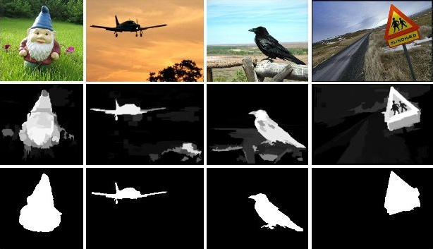

Salient object detection & weak superv.
Global Contrast based Salient Region Detection, IEEE TPAMI 2015 (CVPR 2011). (2000+ citations)

Slide 10
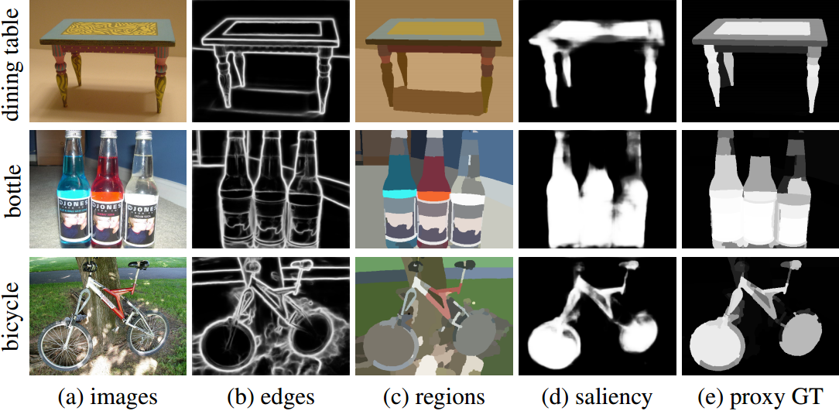
More category-agnostic cues?
WebSeg: Learning Semantic Segmentation from Web Searches, arXiv, 2018.
Richer Convolutional Features for Edge Detection, IEEE CVPR 2017.
Deeply supervised salient object detection with short connections, IEEE TPAMI 2018 (CVPR’17).

Slide 11
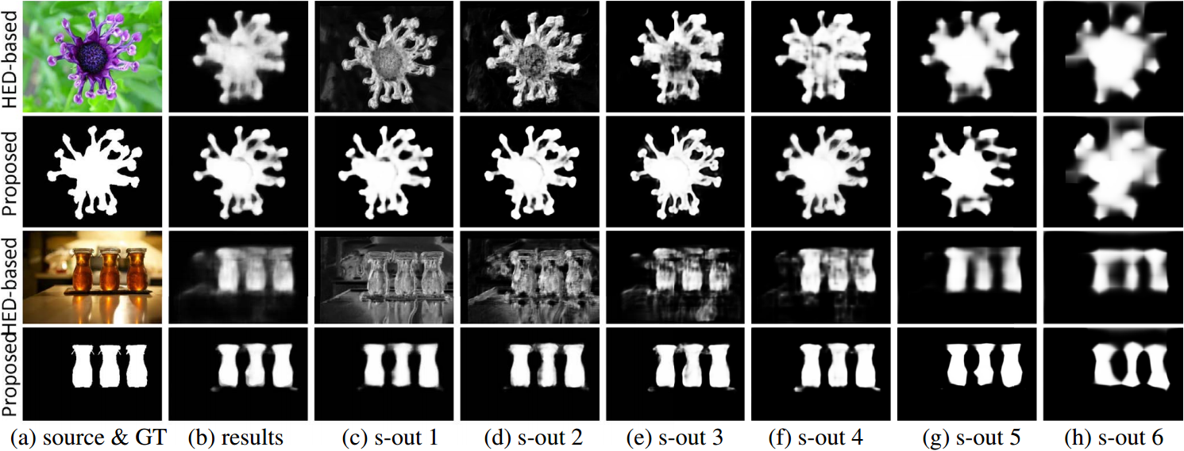
Salient object detections (SOD)
Deeply supervised salient object detection with short connections, IEEE TPAMI 2018 (CVPR’17).

Slide 12
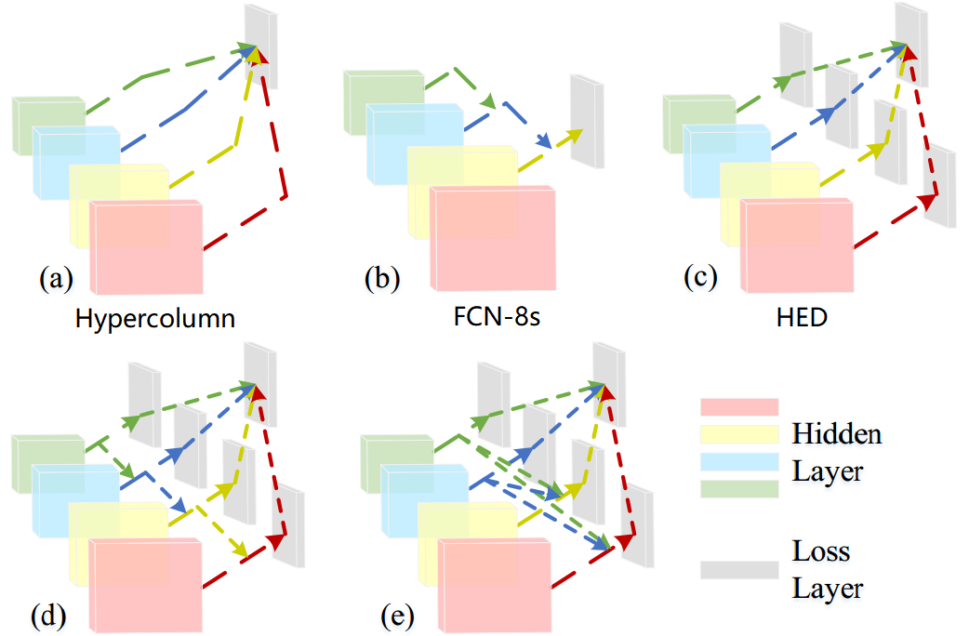
Utilizing multi-scale features

Slide 13
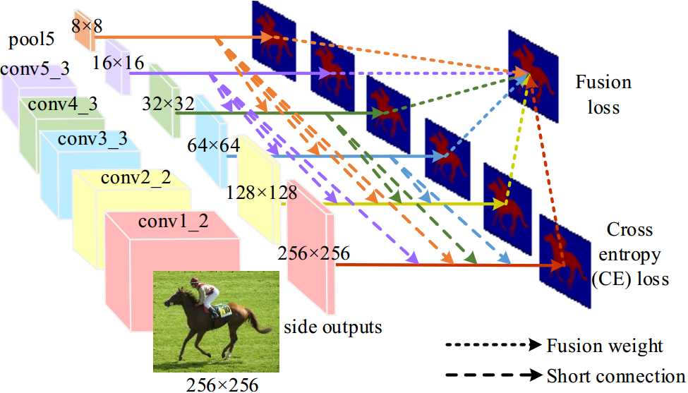
Bridging between multi-levels

Slide 14
Bridging between multi-levels

Slide 15
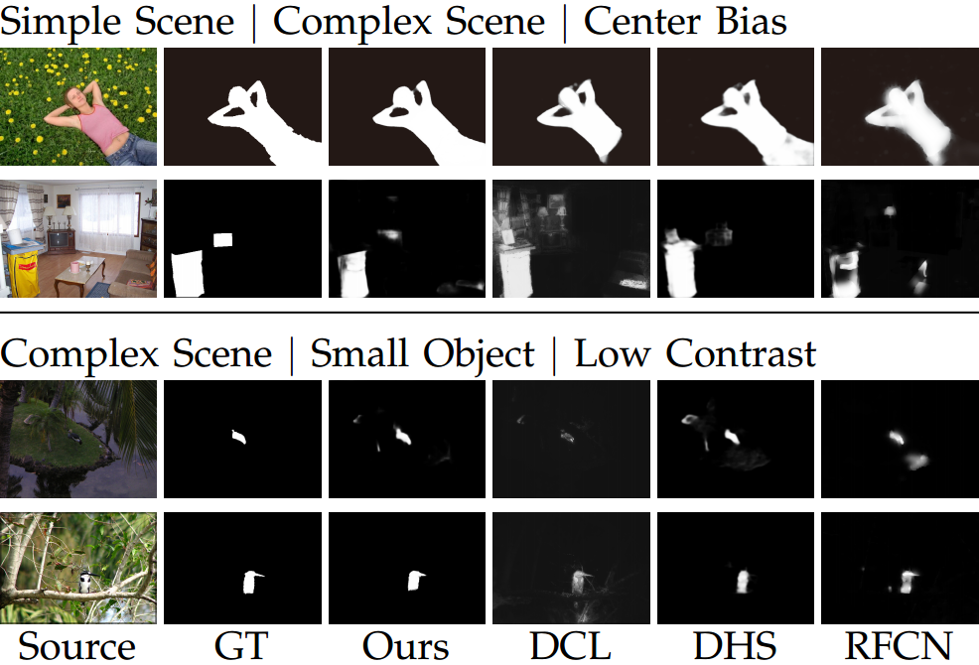
Sample results

Slide 16
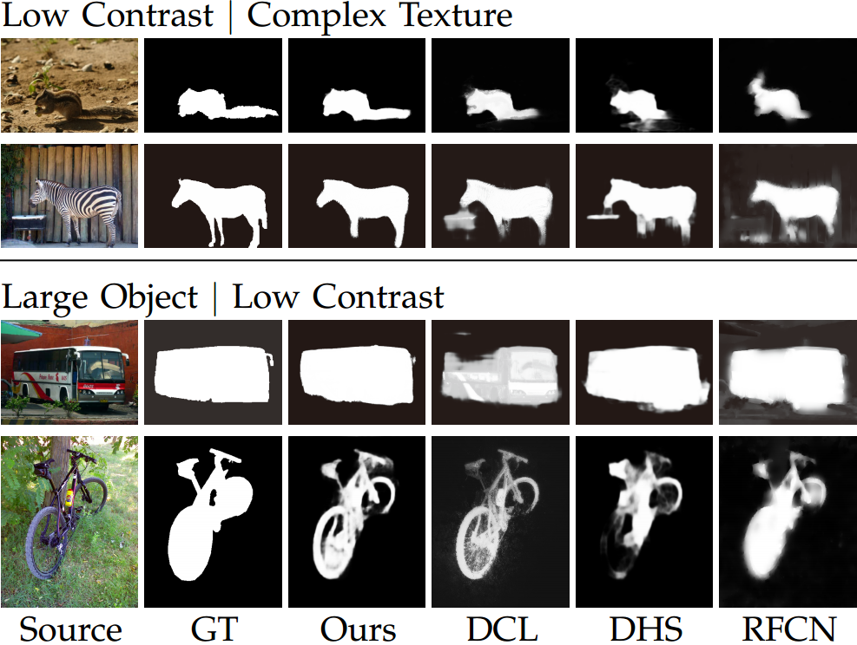
Sample results

Slide 17
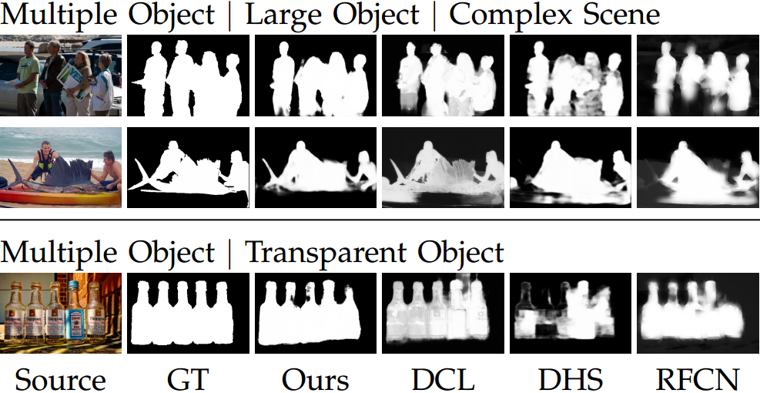
Sample results

Slide 18
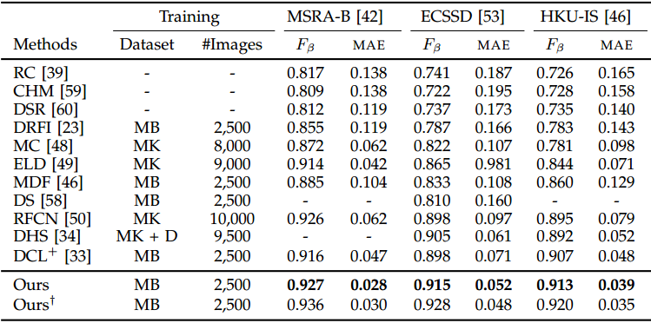
Messages from numbers

Slide 19
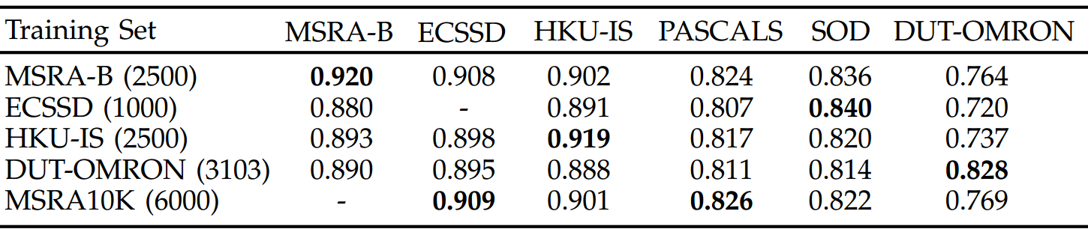
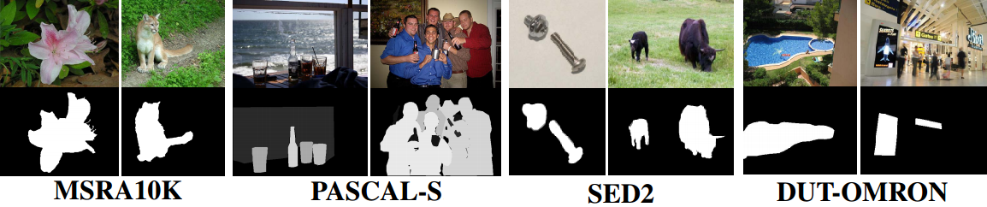
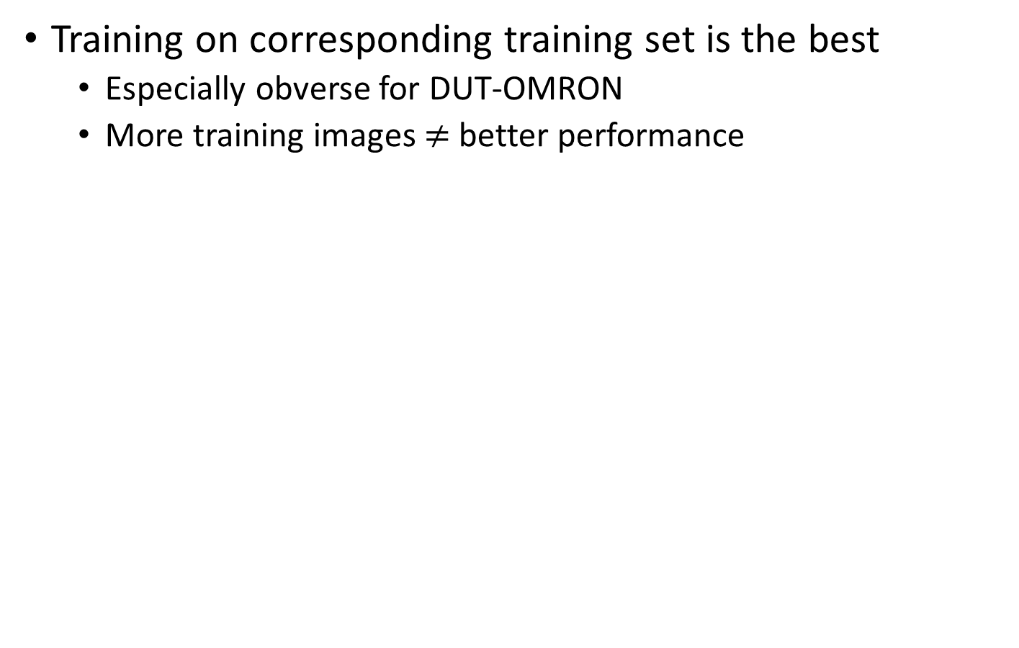
Performance (use different dataset)
Training on corresponding training set is the best
Especially obverse for DUT-OMRON
More training images $≠$ better performance

Slide 20
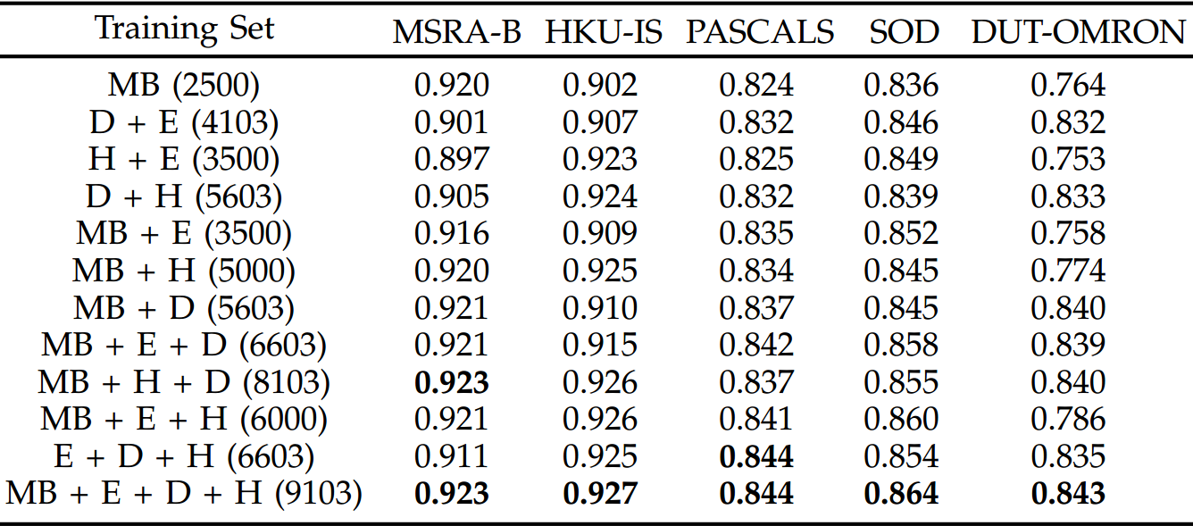
Performance (use different dataset)
Construct a unified, composite, and versatile dataset
Online benchmark: https://mmcheng.net/dss/
All results are obtained without any post-processing.

Slide 21
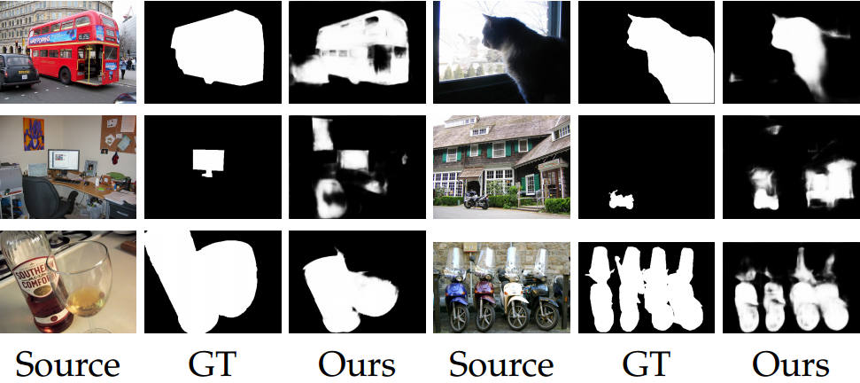
Failure cases

Slide 22

Sample Applications

Slide 23
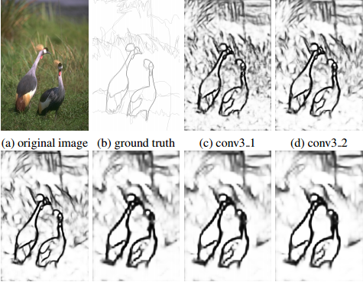
Edge detection
Richer Convolutional Features for Edge Detection, IEEE CVPR 2017.

Slide 24
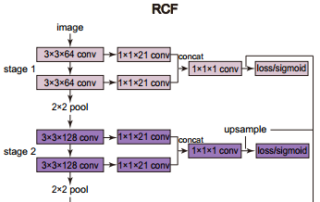
Richer Convolutional Features
Notes:
Traditional deep learning architecture only use the final conv-layer in each stage, which is defined by all conv-layers between two pooling layers. The proposed RCF architecture extends HED to use instead ALL the layers in each stage.

Slide 25
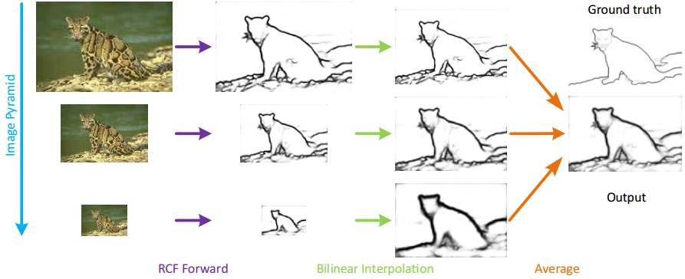
Explicit multi-scale still helps

Slide 26
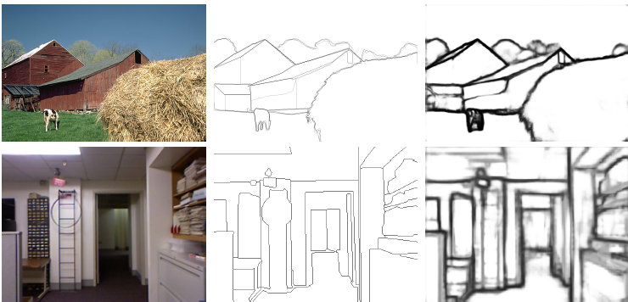
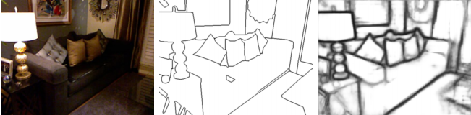
Samples
image
G-Truth
results
Notes:
Some examples of RCF. From top to bottom: BSDS500, NYUD, Multicue-Boundary, and Multicue-Edge. From left to right: origin image, ground truth, RCF edge map, origin image, ground truth, and RCF edge map.

Slide 27
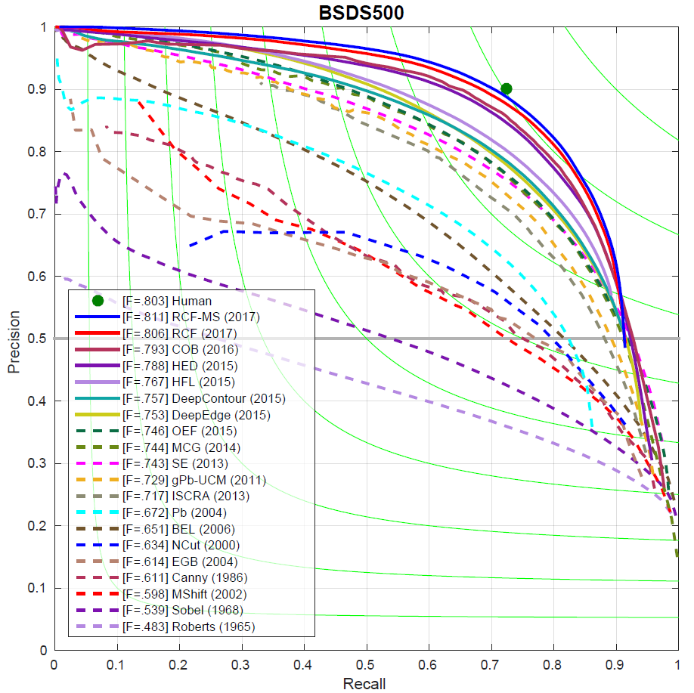
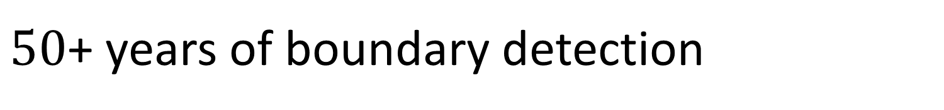
$50$+ years of boundary detection
Since Roberts (1965)

Slide 28
Category-agnostic cues…
WebSeg: Learning Semantic Segmentation from Web Searches, arXiv, 2018.
Richer Convolutional Features for Edge Detection, IEEE CVPR 2017.
Deeply supervised salient object detection with short connections, IEEE TPAMI 2018 (CVPR’17).

Slide 29
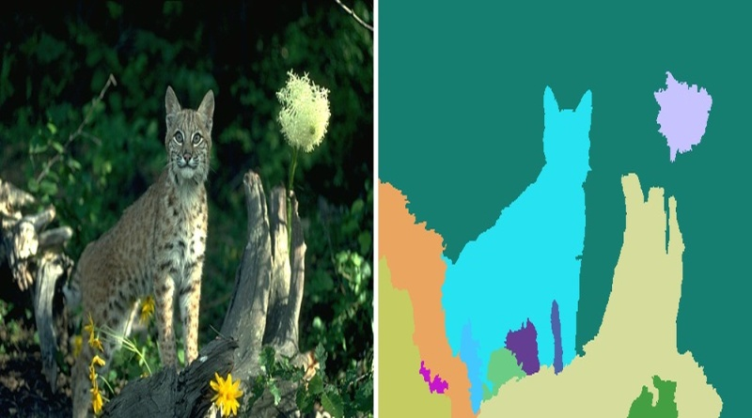
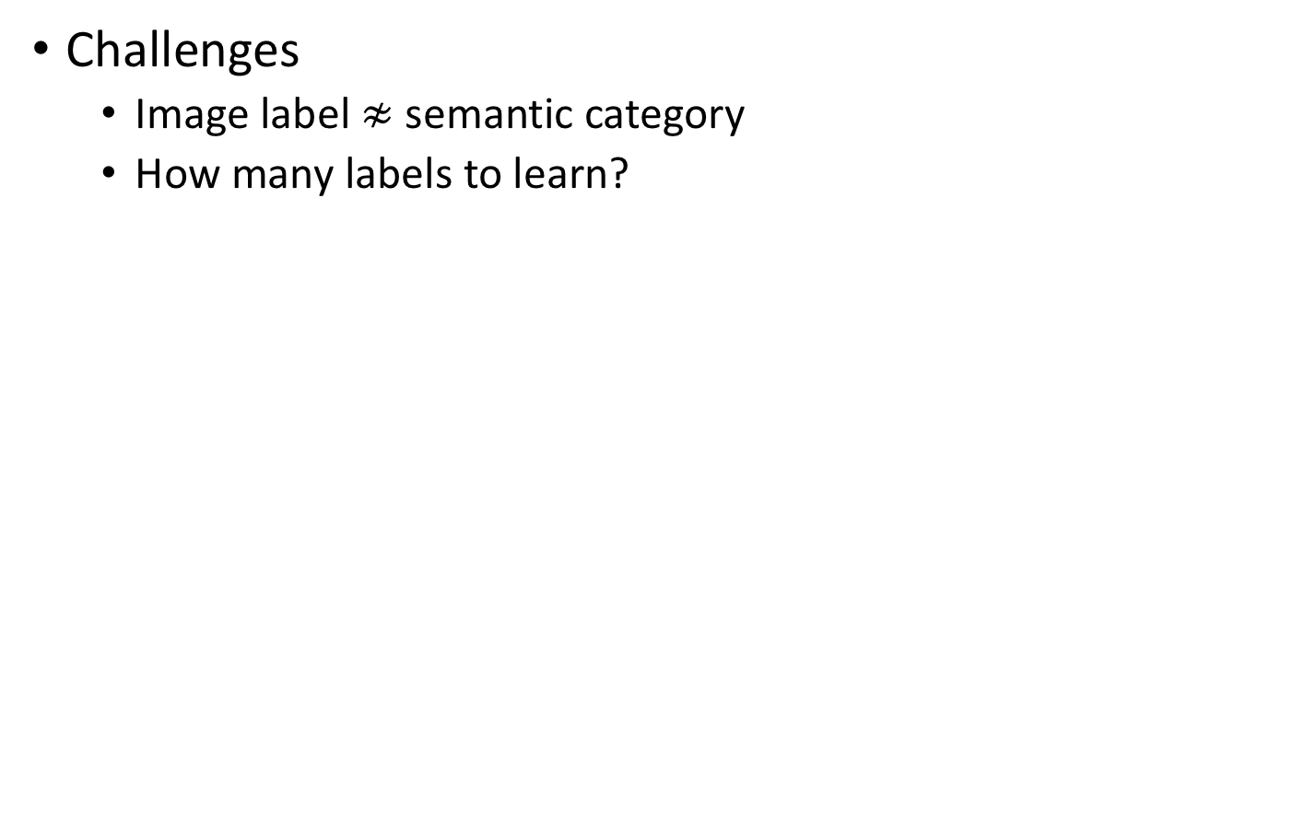
Over-segmentation
Challenges
Image label $≉$ semantic category
How many labels to learn?
HFS: Hierarchical Feature Selection for Efficient Image Segmentation, ECCV 2016.
DEL: Deep Embedding Learning for Efficient Image Segmentation, IJCAI 2018.

Slide 30
Deep Embedding Learning

Slide 31
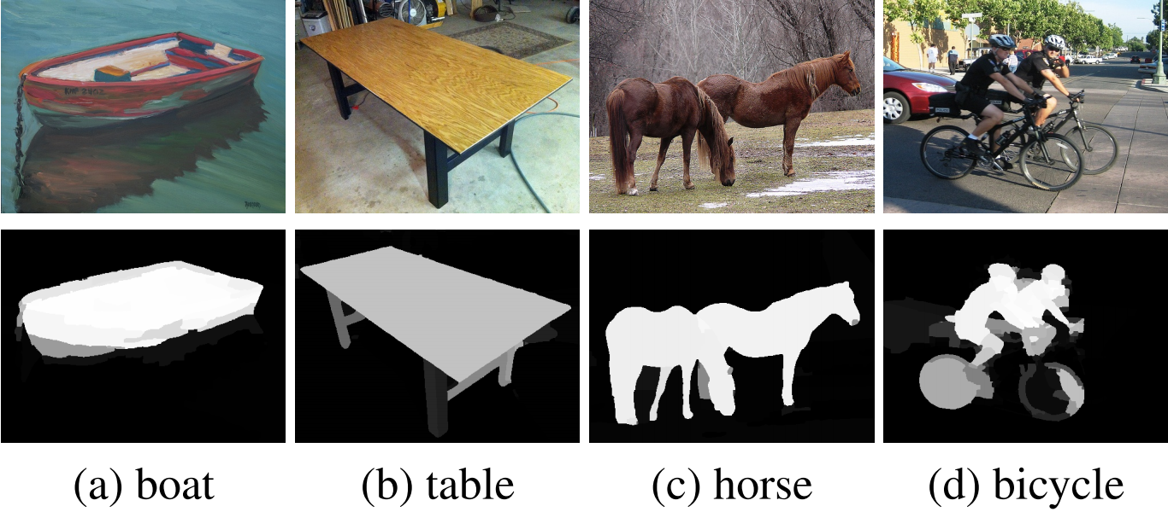
Proxy GT from web searches

Slide 32
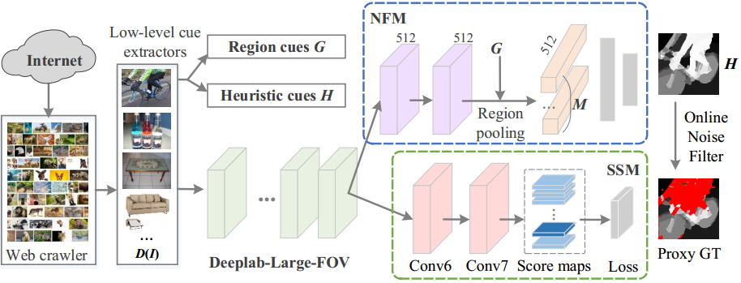
Our framework

Slide 33
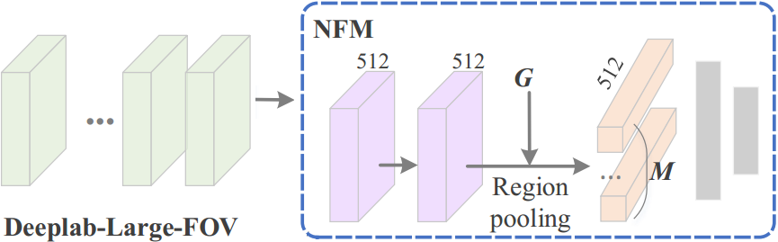
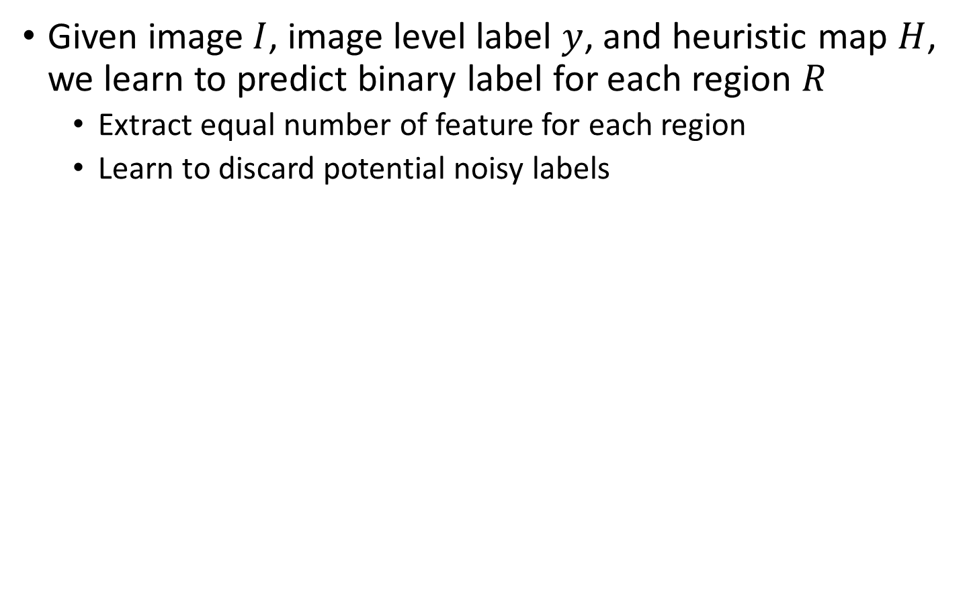
Noise Filtering Module (NFM)
Given image $I$, image level label $y$, and heuristic map $H$, we learn to predict binary label for each region $R$
Extract equal number of feature for each region
Learn to discard potential noisy labels

Slide 34
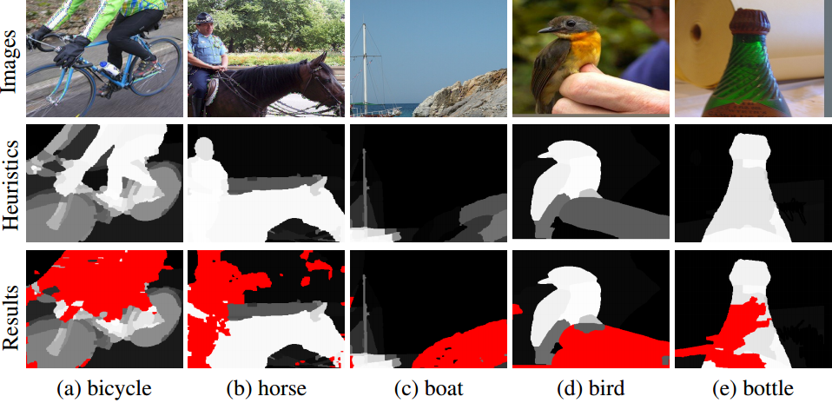
Learning to Filter Noisy Labels

Slide 35
Testing phase
NFM only used during testing

Slide 36
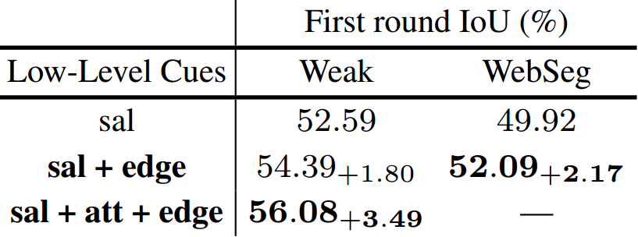
Effective of using different cues
PASCAL VOC 2012 validation set, no post-processing

Slide 37
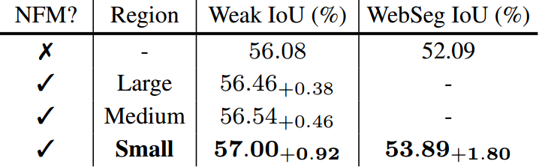
The role of NFM

Slide 38
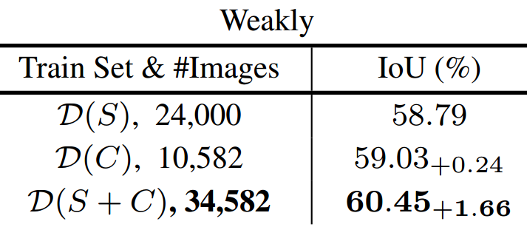
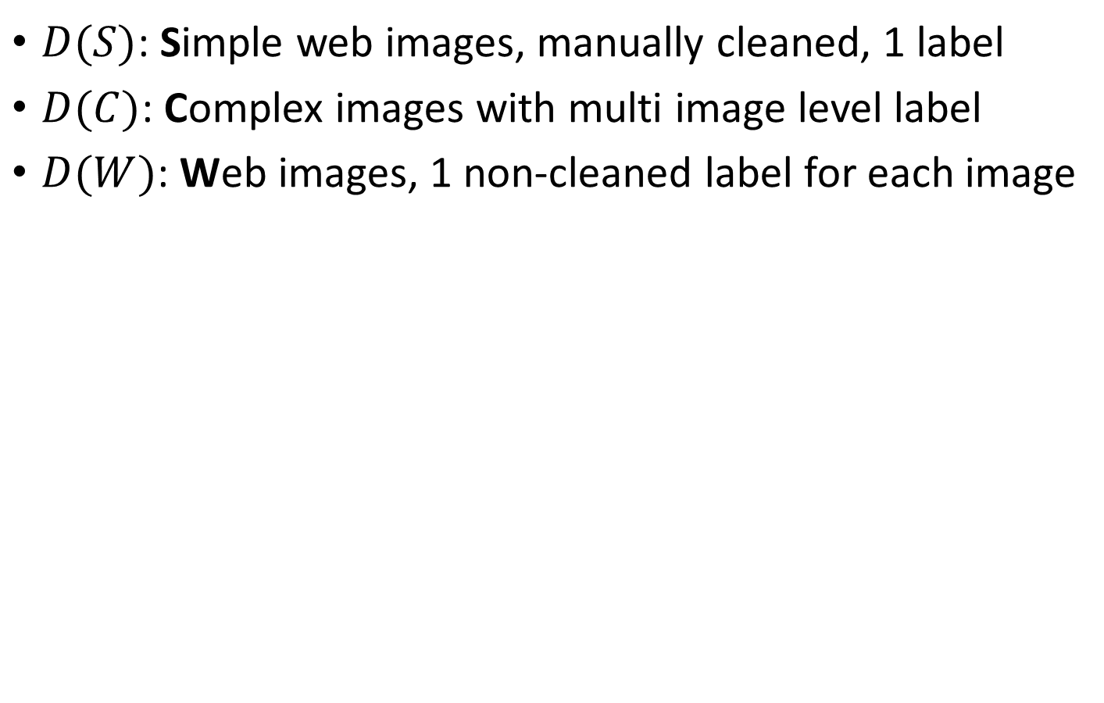
Using different training data
$D(S)$: Simple web images, manually cleaned, 1 label
$D(C)$: Complex images with multi image level label
$D(W)$: Web images, 1 non-cleaned label for each image

Slide 39
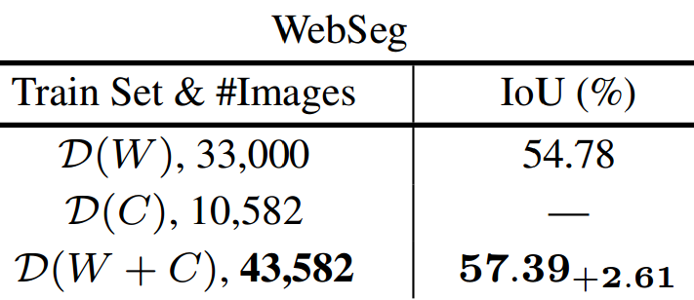
Using different training data
$D(S)$: Simple web images, manually cleaned, 1 label
$D(C)$: Complex images with multi image level label
$D(W)$: Web images, 1 non-cleaned label for each image

Slide 40
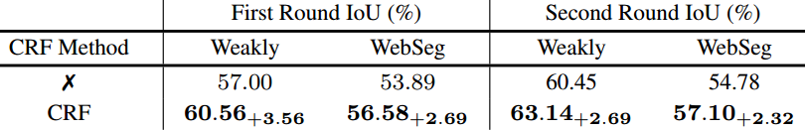
Using CRF

Slide 41
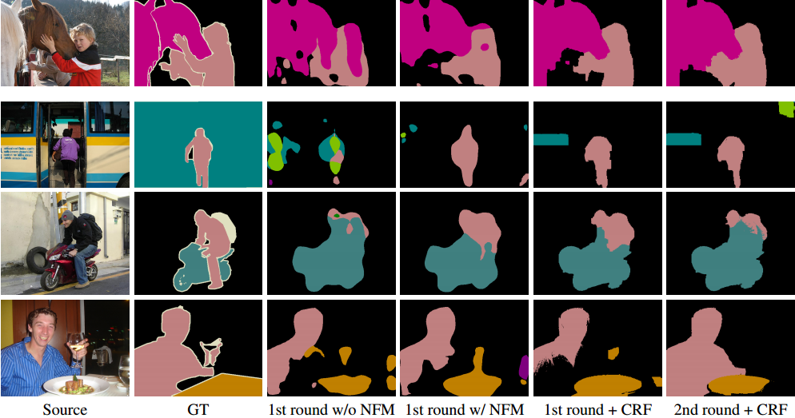
Visual comparisons

Slide 42
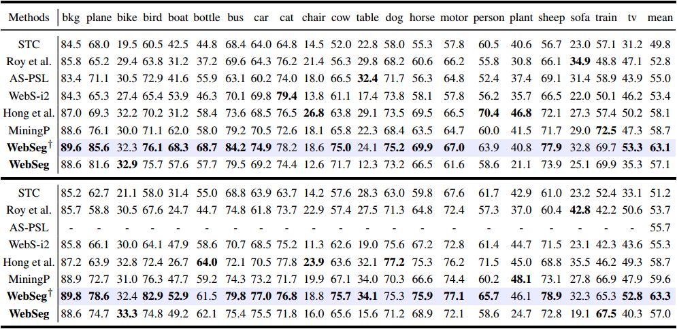
Results on validation & test set

Slide 43
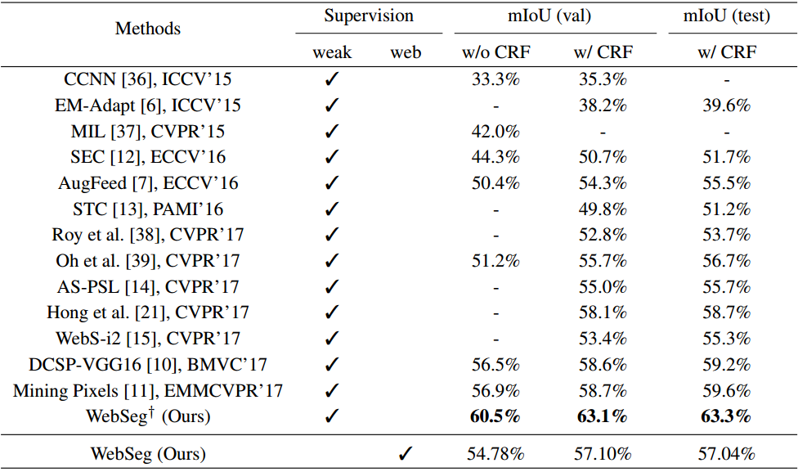
Comparisons

Slide 44
Conclusion
Propose an interesting/challenging vision problem
WebSeg: learning semantic segmentation from web directly
An online noisy filtering mechanism
Let CNNs know how to discard undesired noisy regions

Slide 45
Future works
Never ending learning
Effectively select good web images to learn from
Customized salient object detection
Improve the quality of heuristic cues
Noise filtering mechanisms
Other tasks using purely web supervision
We only touched the surface of purely web supervision!

Slide 46
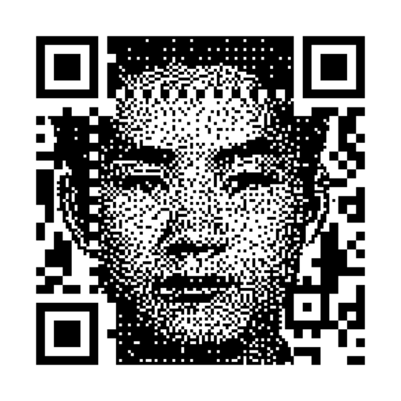
Source code
free

Slide 47
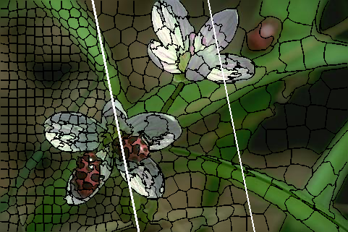
Some closely related projects
FLIC: Fast Linear Iterative Clustering with Active Search, AAAI 2018.

Slide 48
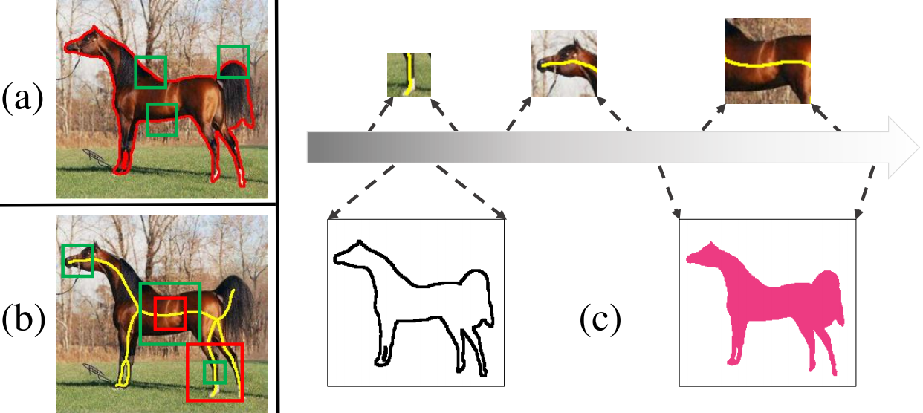
Some closely related projects
Hi-Fi: Hierarchical Feature Integration for Skeleton Detection, IJCAI 2018.

Slide 49
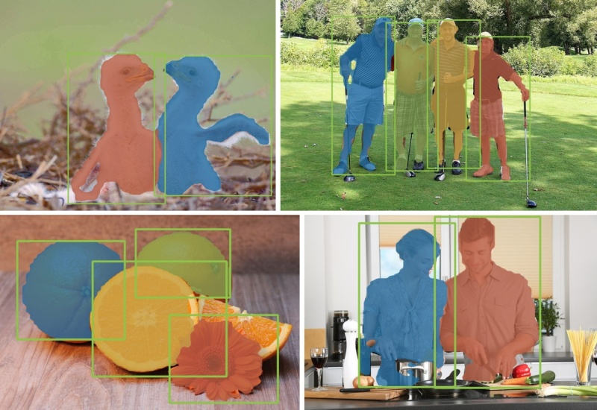
Some closely related projects
S4Net: Single Stage Salient-Instance Segmentation, arXiv 2017.

Slide 50
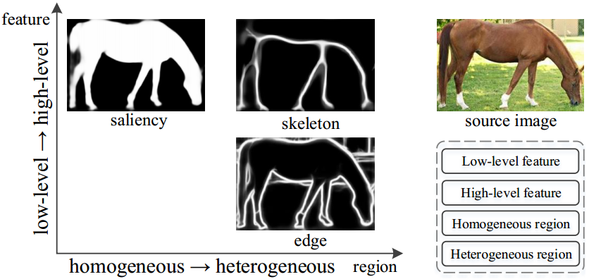
Some closely related projects
Three Birds One Stone: A Unified Framework for Salient Object Segmentation, Edge Detection and Skeleton Extraction, arXiv 2018.

Slide 51
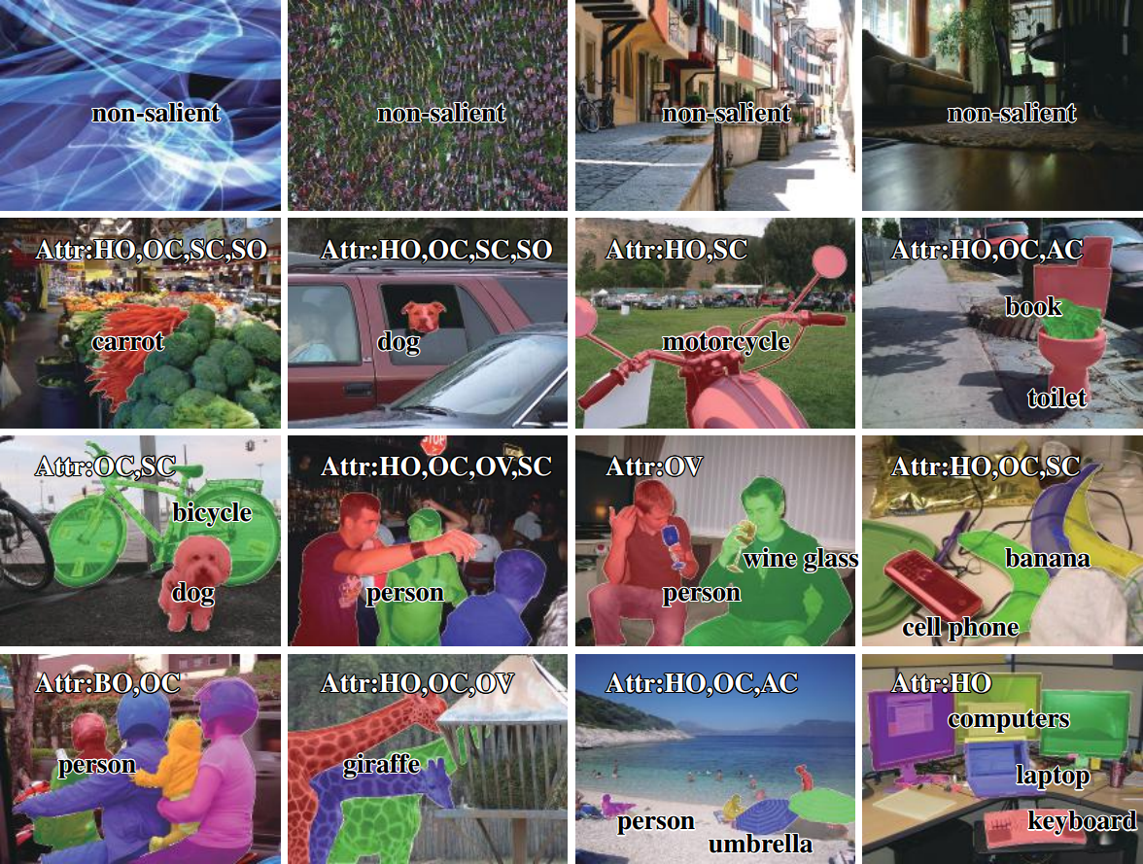
Some closely related projects
Salient Objects in Clutter: Bringing Salient Object Detection to the Foreground, arXiv 2018.

Slide 52
Thanks!
Q&A

